Slide 1
BioMedIA Reading Group
Presenter: Siyi Du
2025-07-03

Slide 2
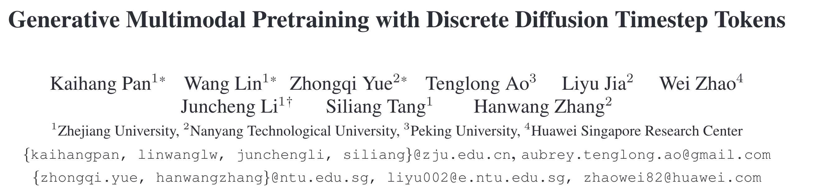
CVPR 2025 (Best Student Paper Honorable Mention)

Slide 3

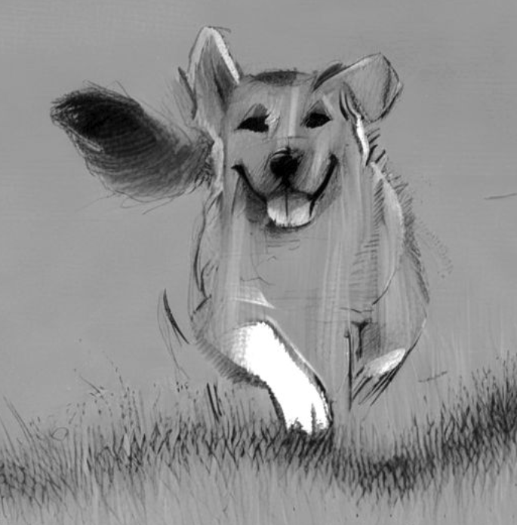
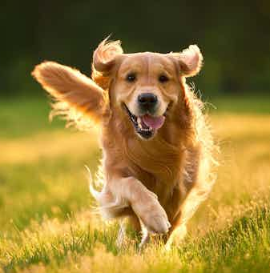
What humans expect from MLLMs
What kind of dog is in this picture [IMG]?
Turning the picture [IMG] into a sketch.
Golden retrieval.
MLLM
MLLM
Visual comprehension
Visual generation
Challenges in unifying these two objectives
Comprehension: pursues many-to-one mapping
Generation: one-to-one mapping

Slide 4
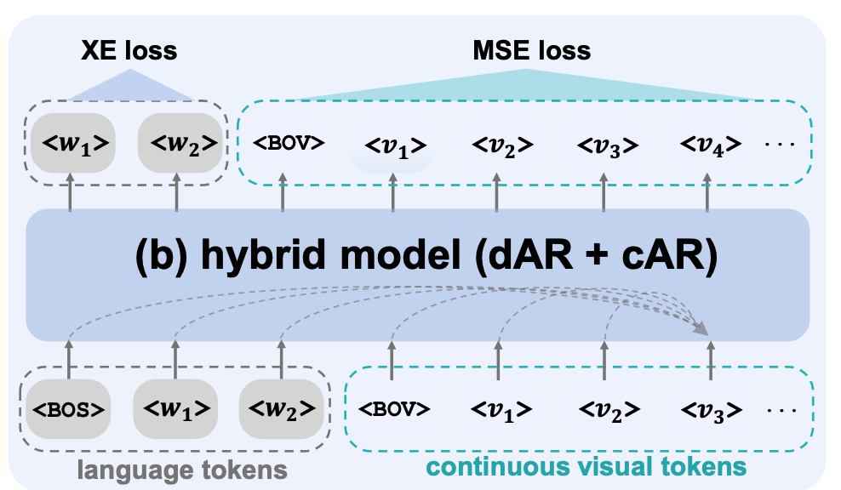
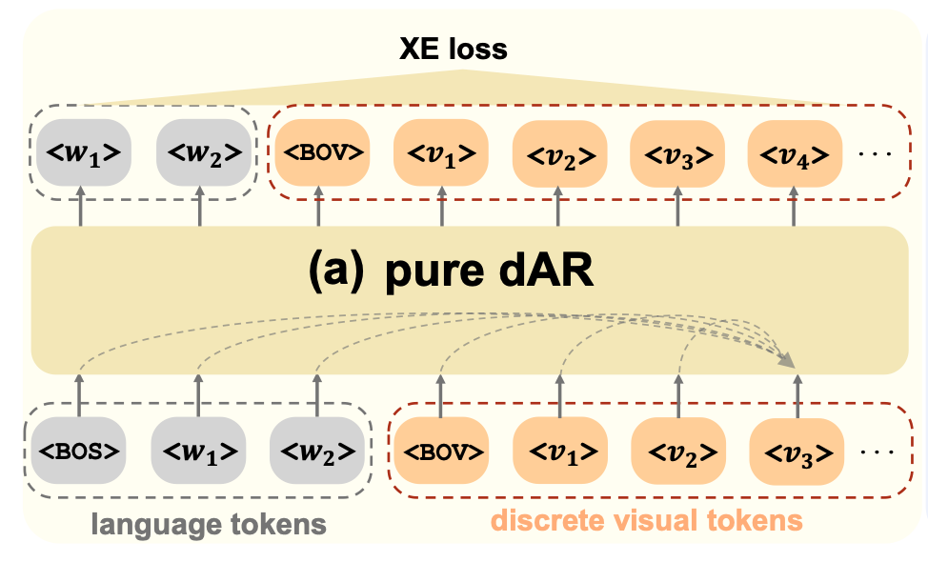
Combine LLMs and diffusion models
dAR: discrete autoregressive model
cAR: continuous autoregressive model

Slide 5

Combine LLMs and diffusion models
Why discrete?
cAR cannot inherit the successful infrastructure and training paradigm of LLMs
cAR is more error-prone in next-token prediction
cAR introduces unnecessary complexity
Continuous representations are less disentangled

Slide 6
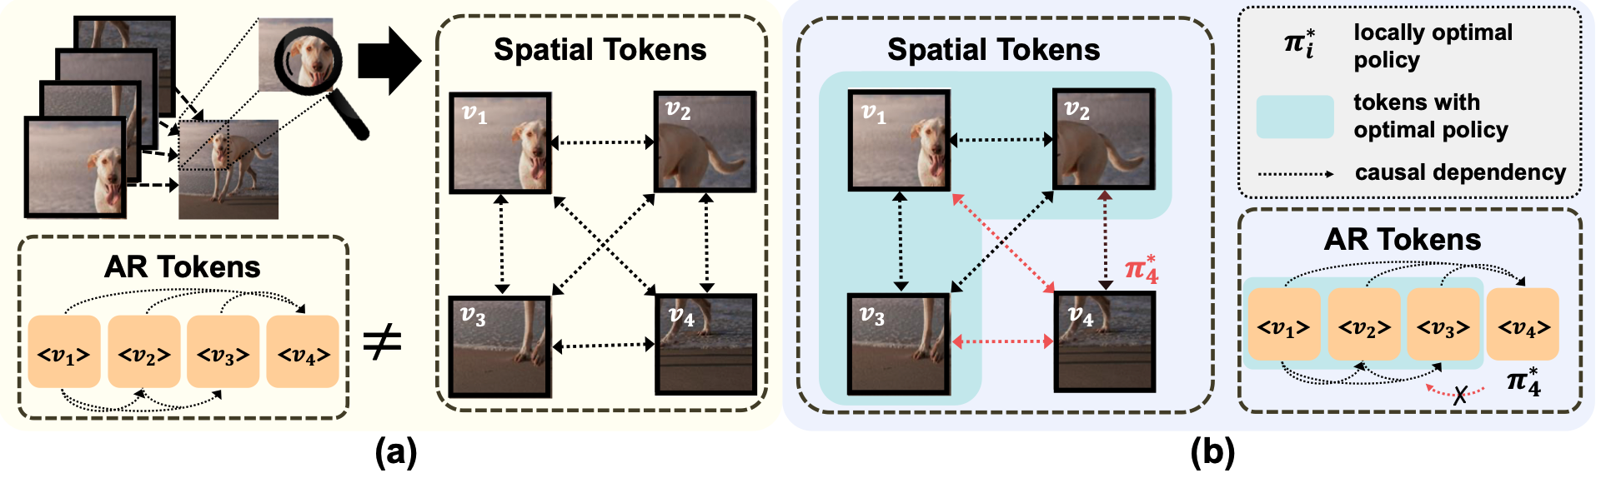
Why not spatial tokenization?
Spatial tokens used in existing work are not autoregressive.
Form an impossible language for LLM to master and violates policy improvement optimality in RL.

Slide 7
Contribution
Propose to learn visual tokens with recursive structure by discrete diffusion timestep tokenization (DDT)
Propose a novel way to integrate LLMs and diffusion models with their DDT tokens
Achieve a new SOTA for multimodal comprehension and generalization with a tokenizer trained on just ImageNet
Notes:
image generation, image editing, visual comprehension

Slide 8
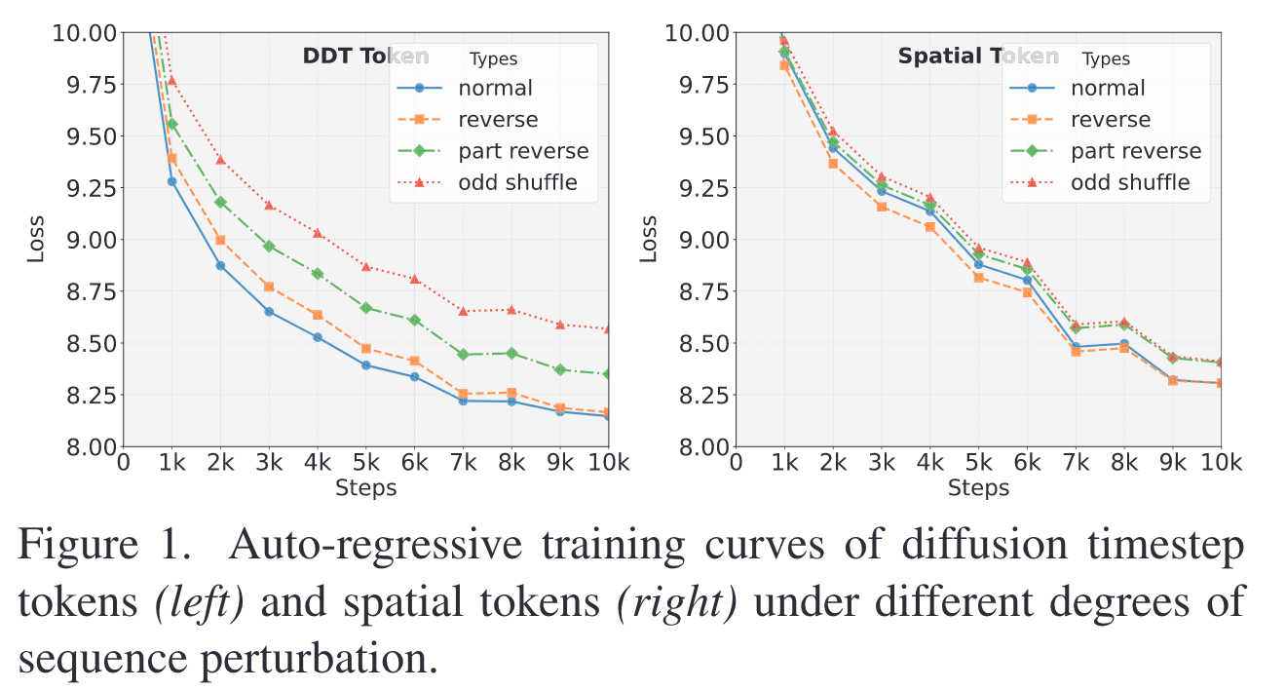
Performance difference across tokens

Slide 9
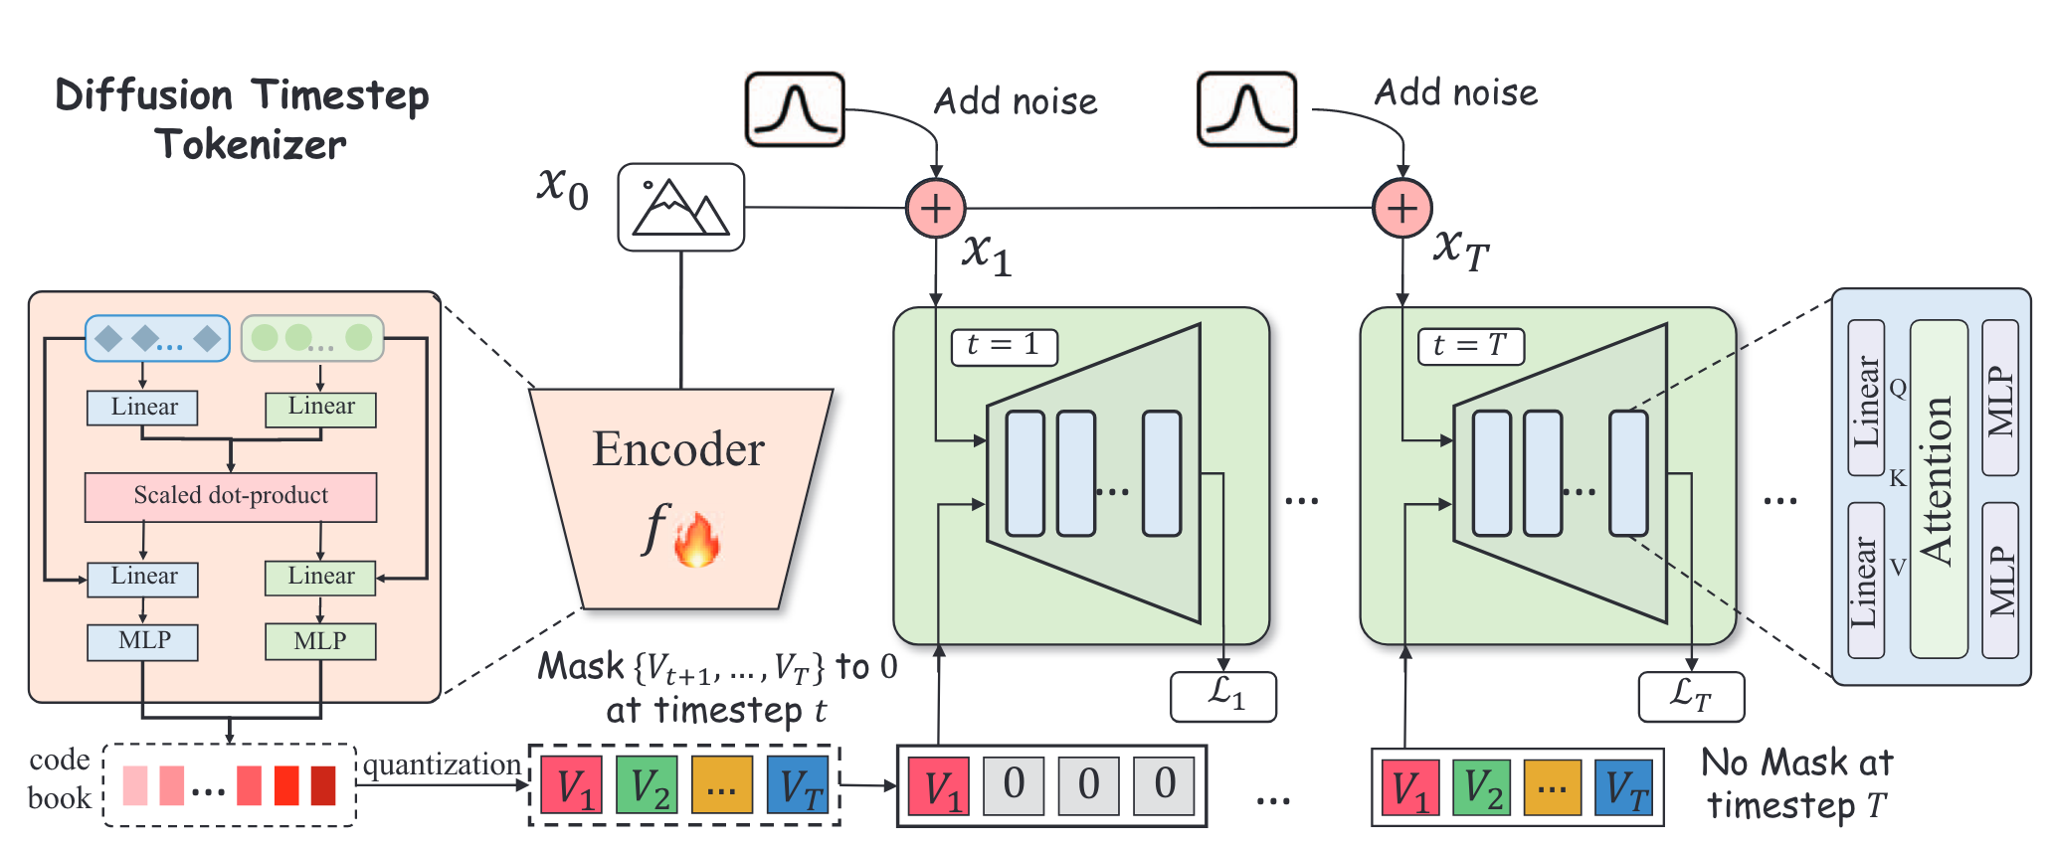
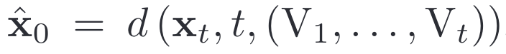
Discrete timestep tokenizer (DDT)
Encoder: map a noise-free image x0 to a sequence of continuous features
Quantizer: assign each continuous feature to its token embedding
Decoder: reconstruct the original image

Slide 10
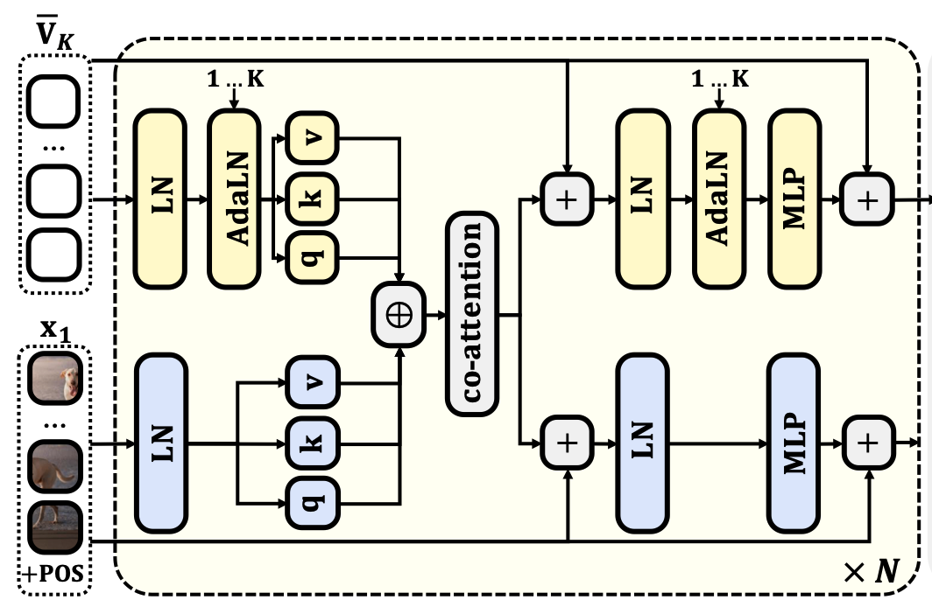
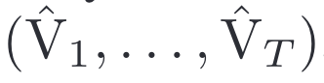
Encoder
Learnable query tokens
Use a dual-stream transformer backbone
Output transformed query tokens

Slide 11
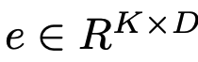
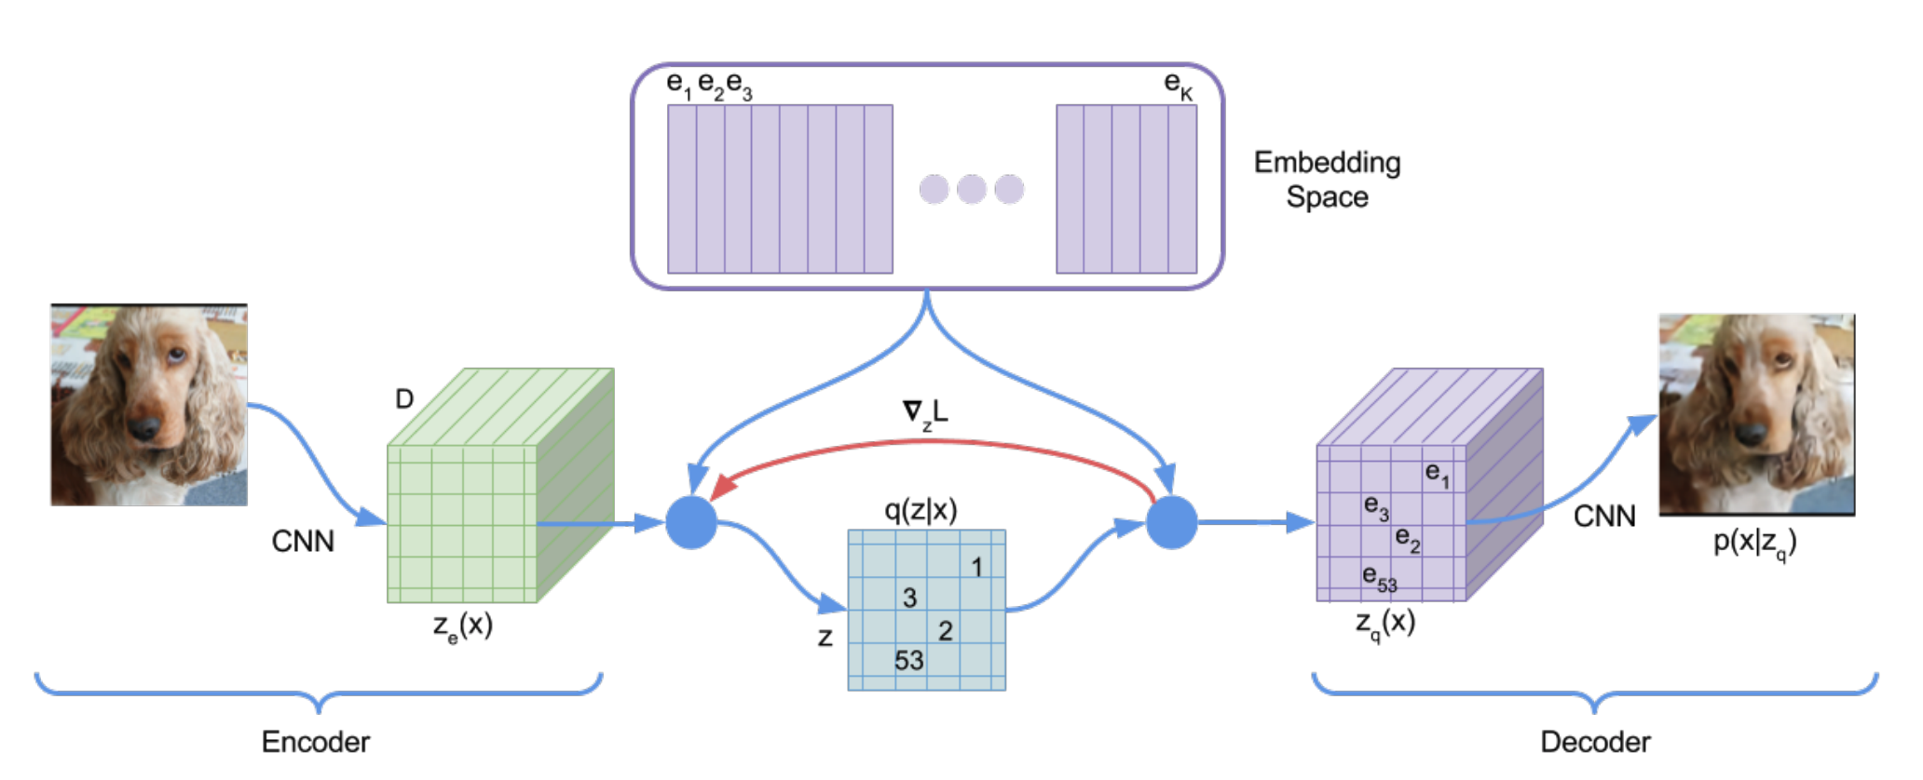
Discrete Representation Learning
Neural Discrete Representation Learning (NIPS 2017)
Define a latent embedding codebook
Each visual feature is replaced by the nearest embedding in the codebook to get z_q(x)
Training objective
Reconstruction loss
Codebook loss
Commitment loss
Encourages the encoder to commit to the chosen codebook entry

Slide 12
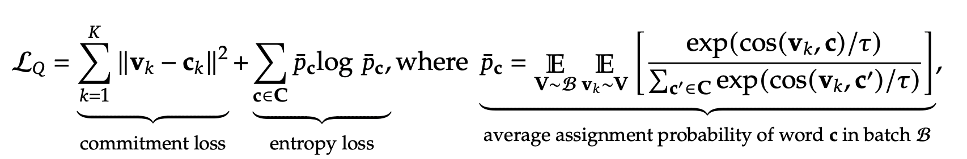
Quantizer
Quantize each visual feature to a token in the codebook

Slide 13
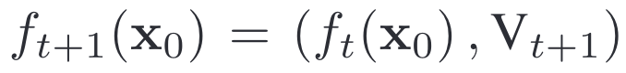
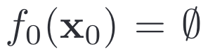
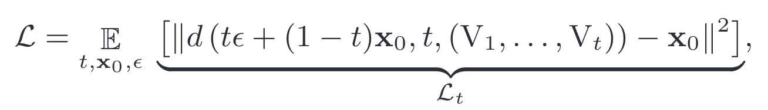
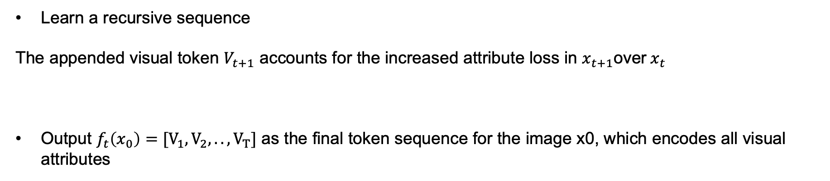
Decoder
Learn a recursive sequence
The appended visual token $V_{t+1}$ accounts for the increased attribute loss in $x_{t+1}$over$x_{t}$
Output $f_{t}\left(x_{0}\right)=[V_{1},V_{2},.., V_{T}]$ as the final token sequence for the image x0, which encodes all visual attributes
f means DDT network

Slide 14
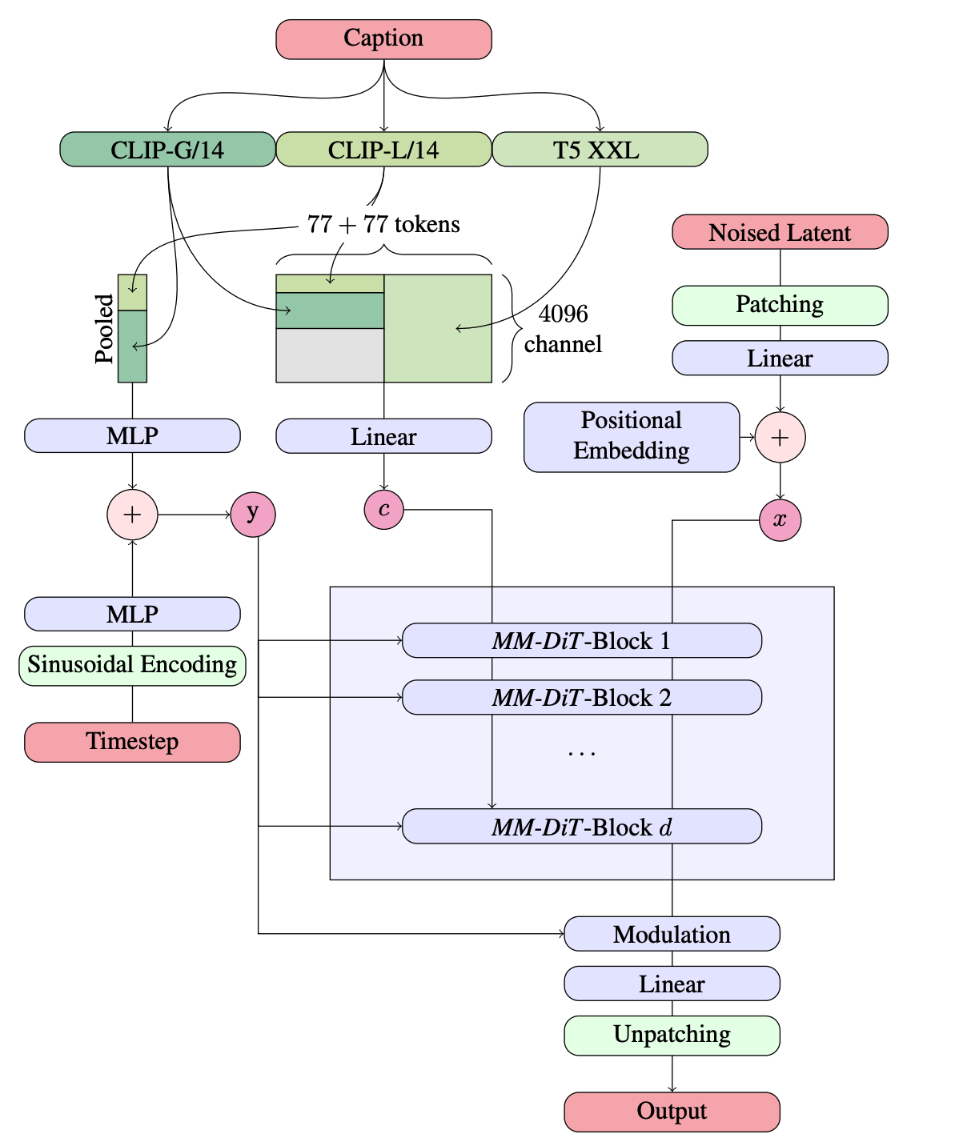
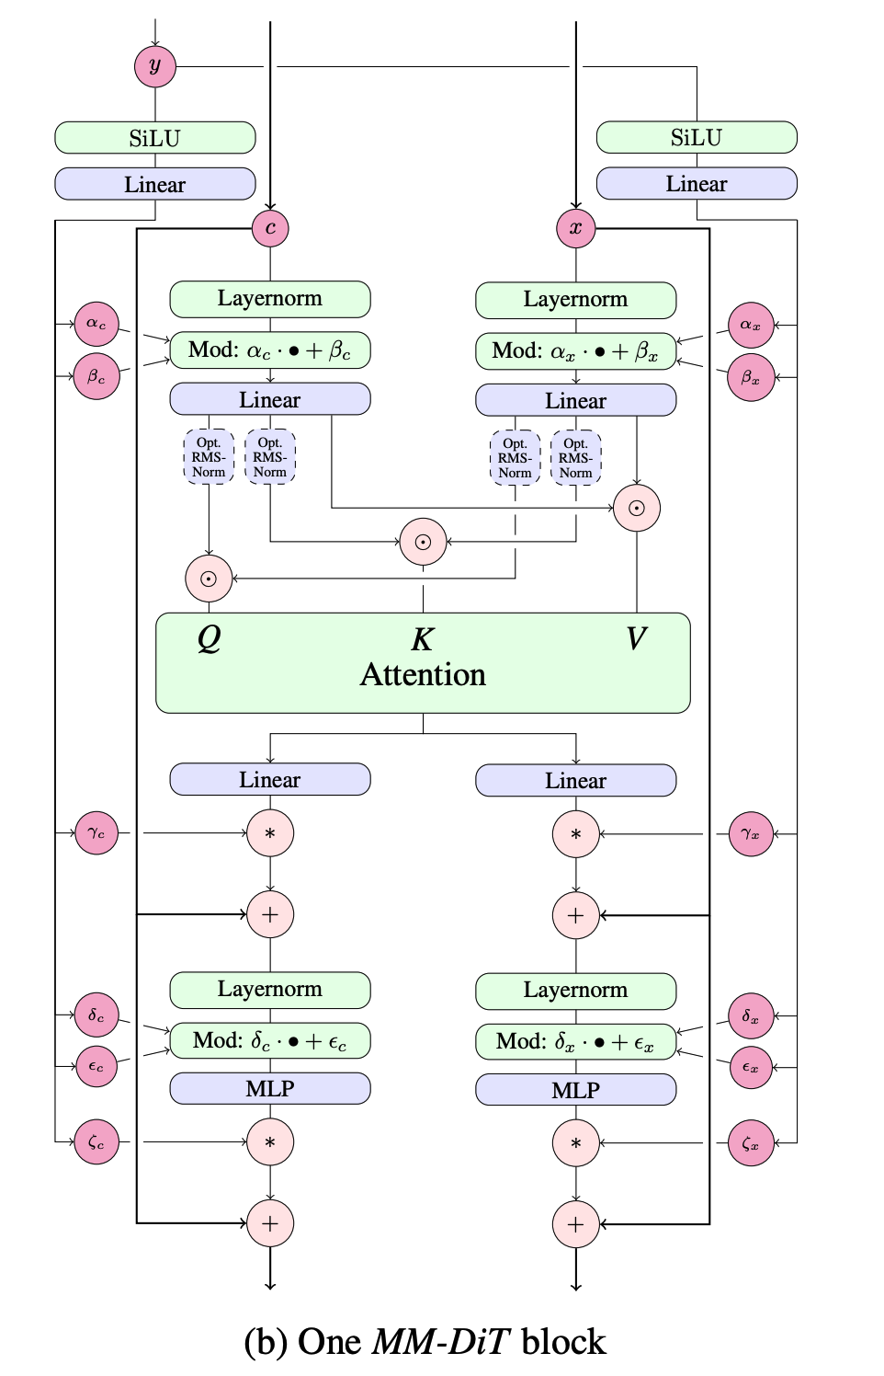
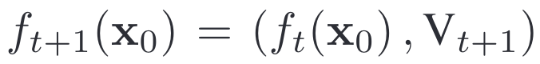
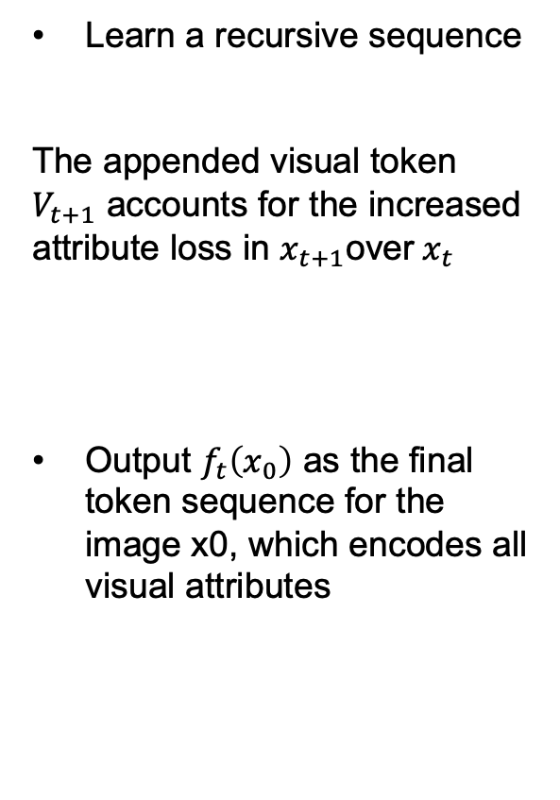
Decoder
Learn a recursive sequence
The appended visual token $V_{t+1}$ accounts for the increased attribute loss in $x_{t+1}$over$x_{t}$
Output $f_{t}\left(x_{0}\right)$ as the final token sequence for the image x0, which encodes all visual attributes
Quantized visual tokens

Slide 15
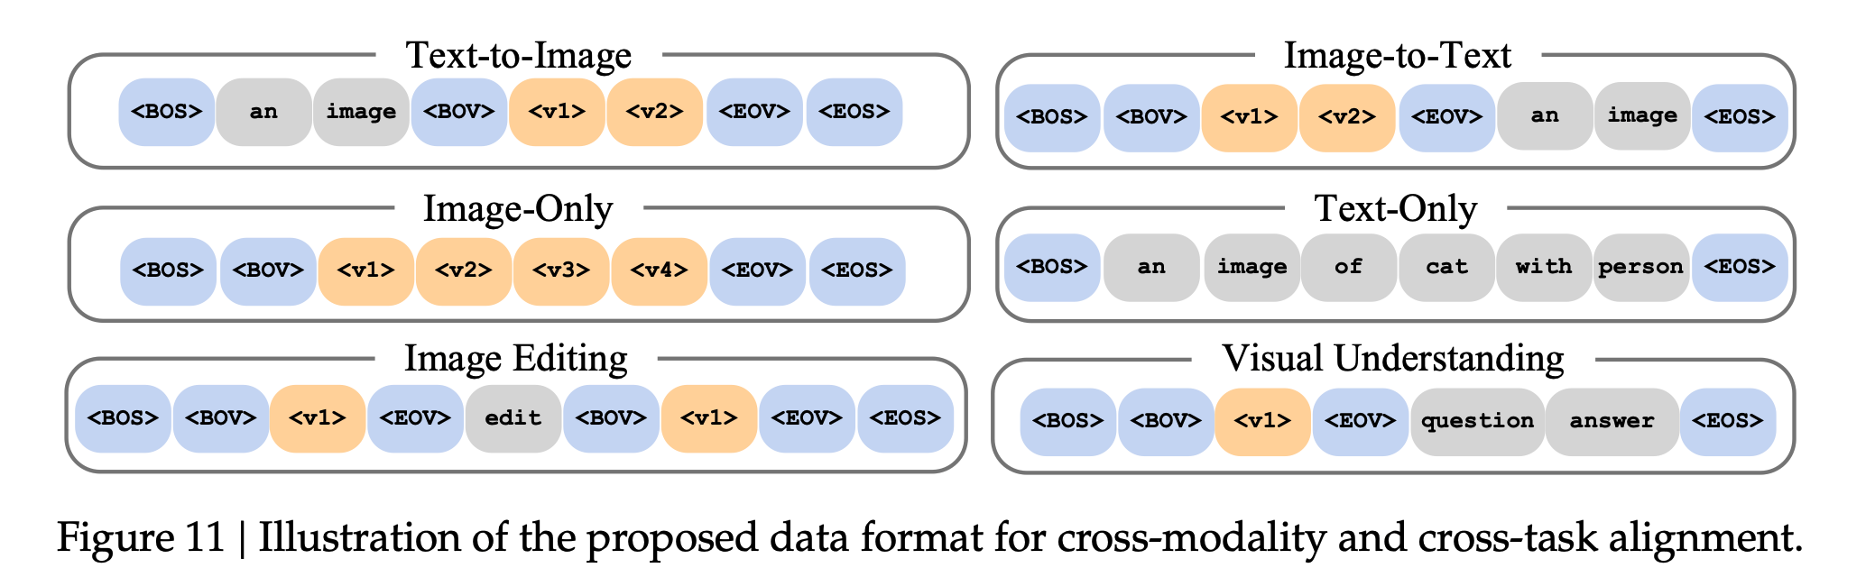
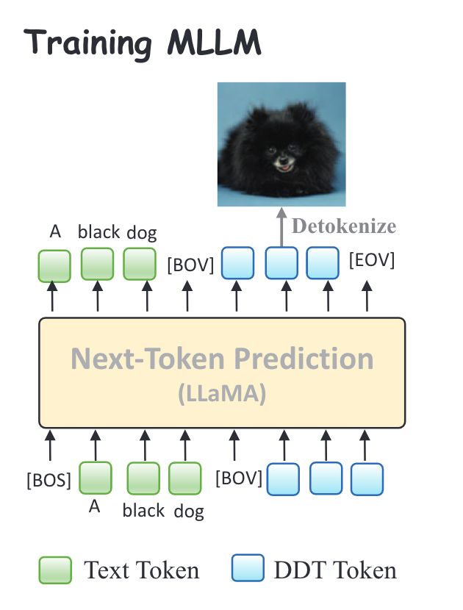
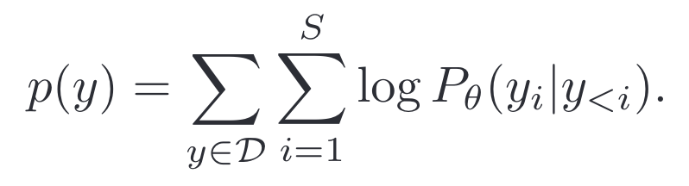
DDT-LLaVA
Training objective
Training stage (DDT is trained on ImageNet and frozen)
Pre-training on 90% text-to-image pairs and 10% pure text data. 512 910B NPUs, two weeks
Supervised instruction tuning

Slide 16
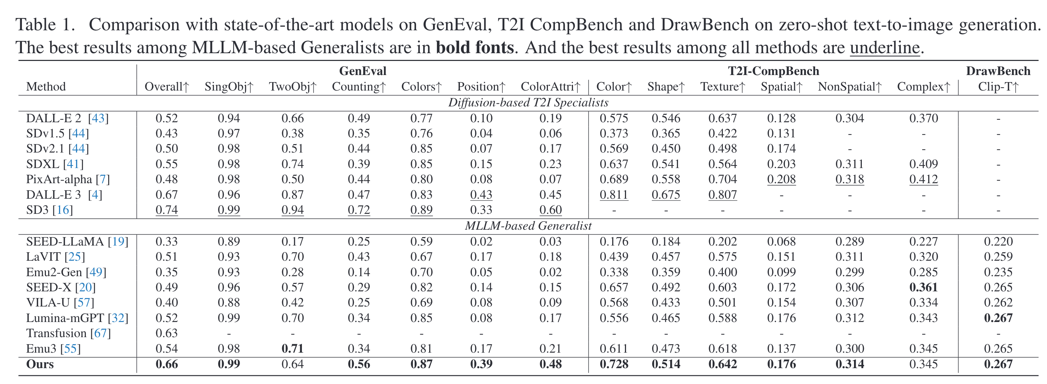
Zero-shot image synthesis

Slide 17
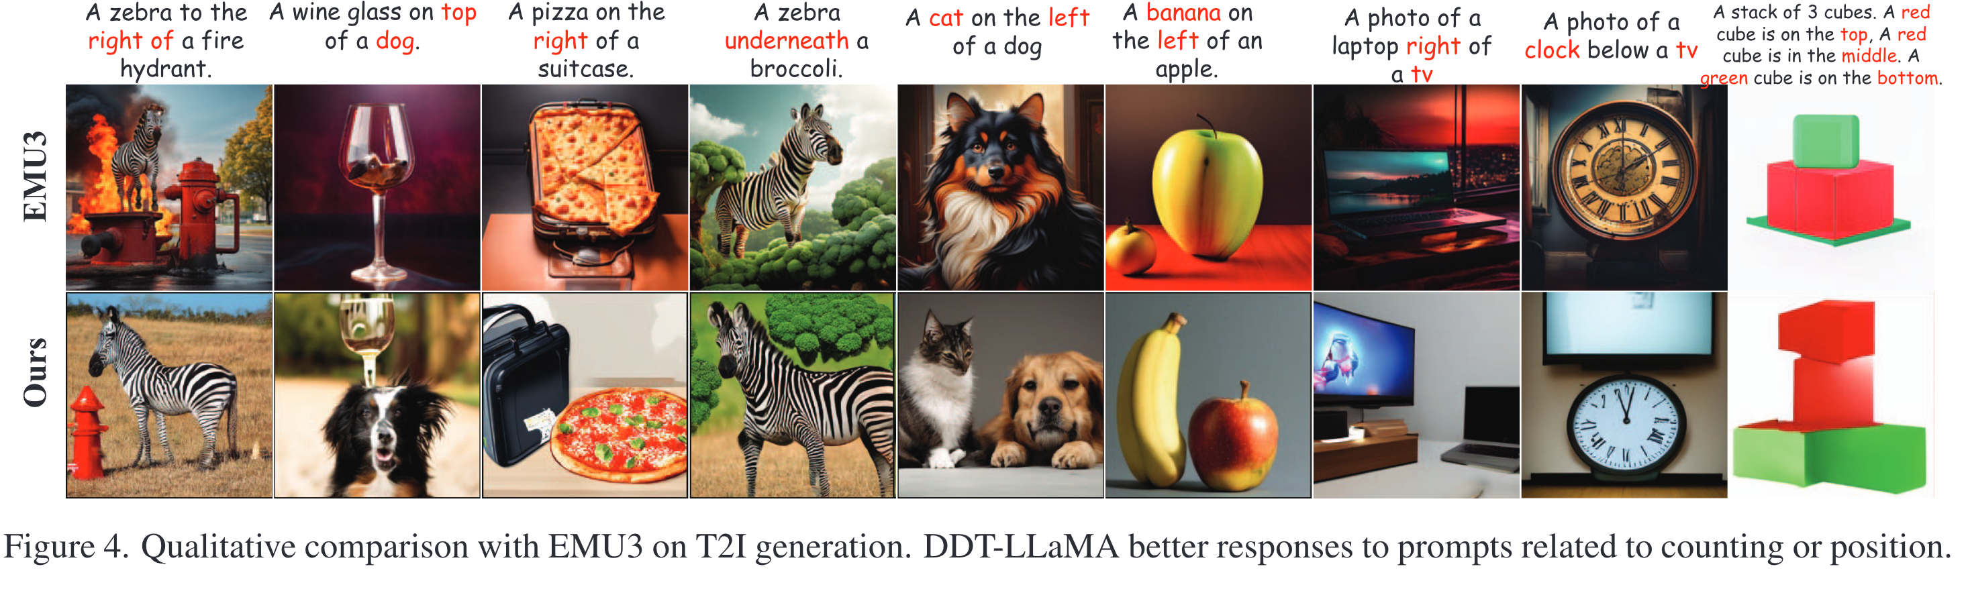
Zero-shot image synthesis
Better align with the object attributes and the spatial relationships specified in the prompt.

Slide 18
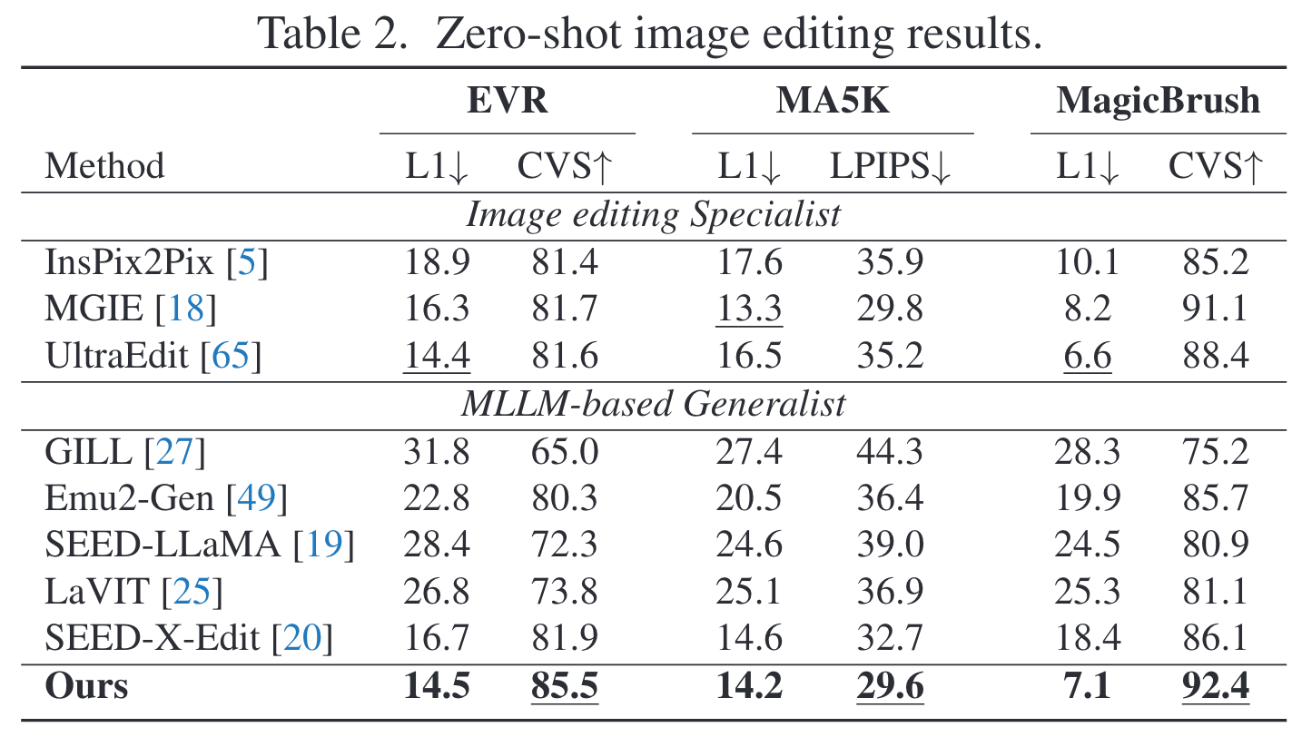
Zero-shot instruction-based image editing

Slide 19
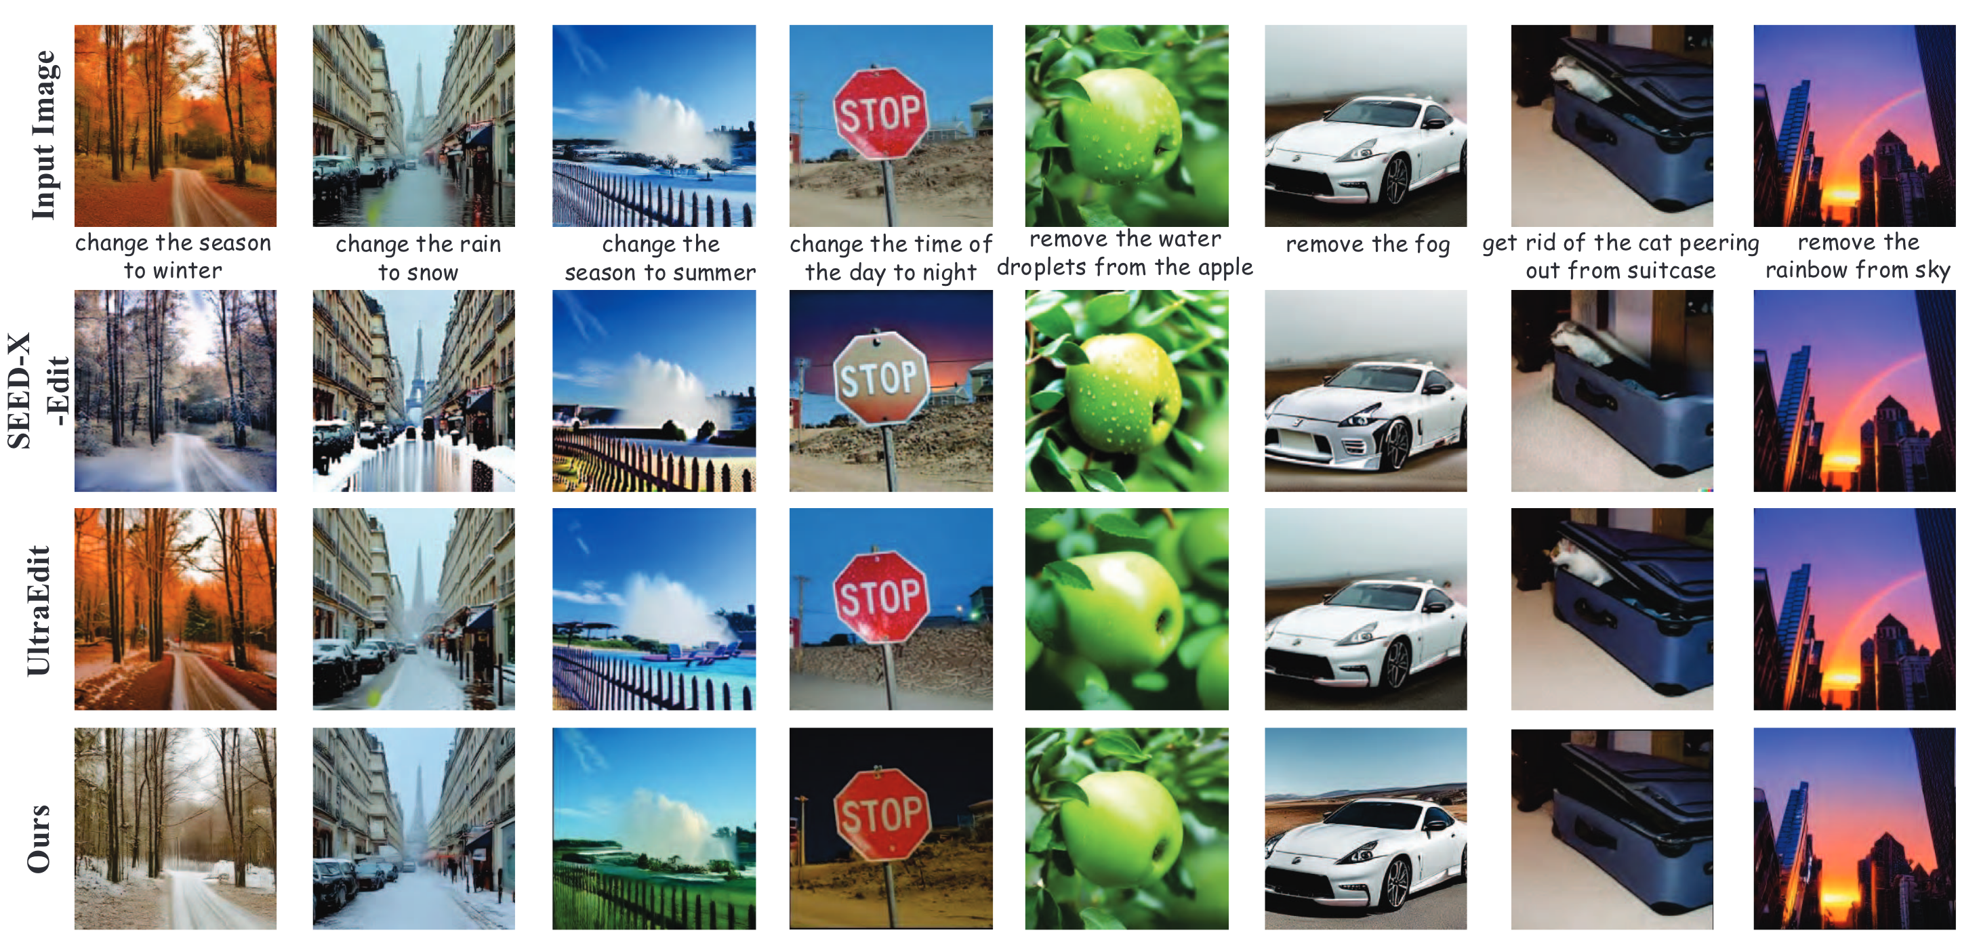
Zero-shot instruction-based image editing
It not only effectively comprehends the instruction to execute editing, but also excels at preserving image fidelity, which is rarely seen in prior work

Slide 20
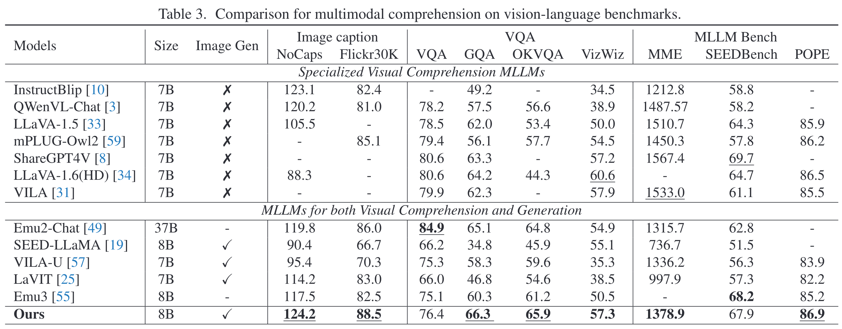
Vision-Language Comprehension

Slide 21
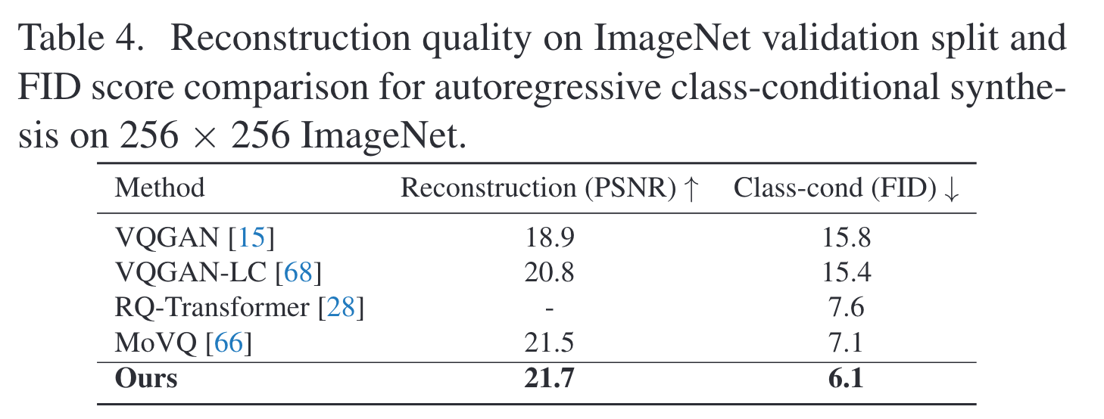
DDT outperforms other spatial tokens

Slide 22
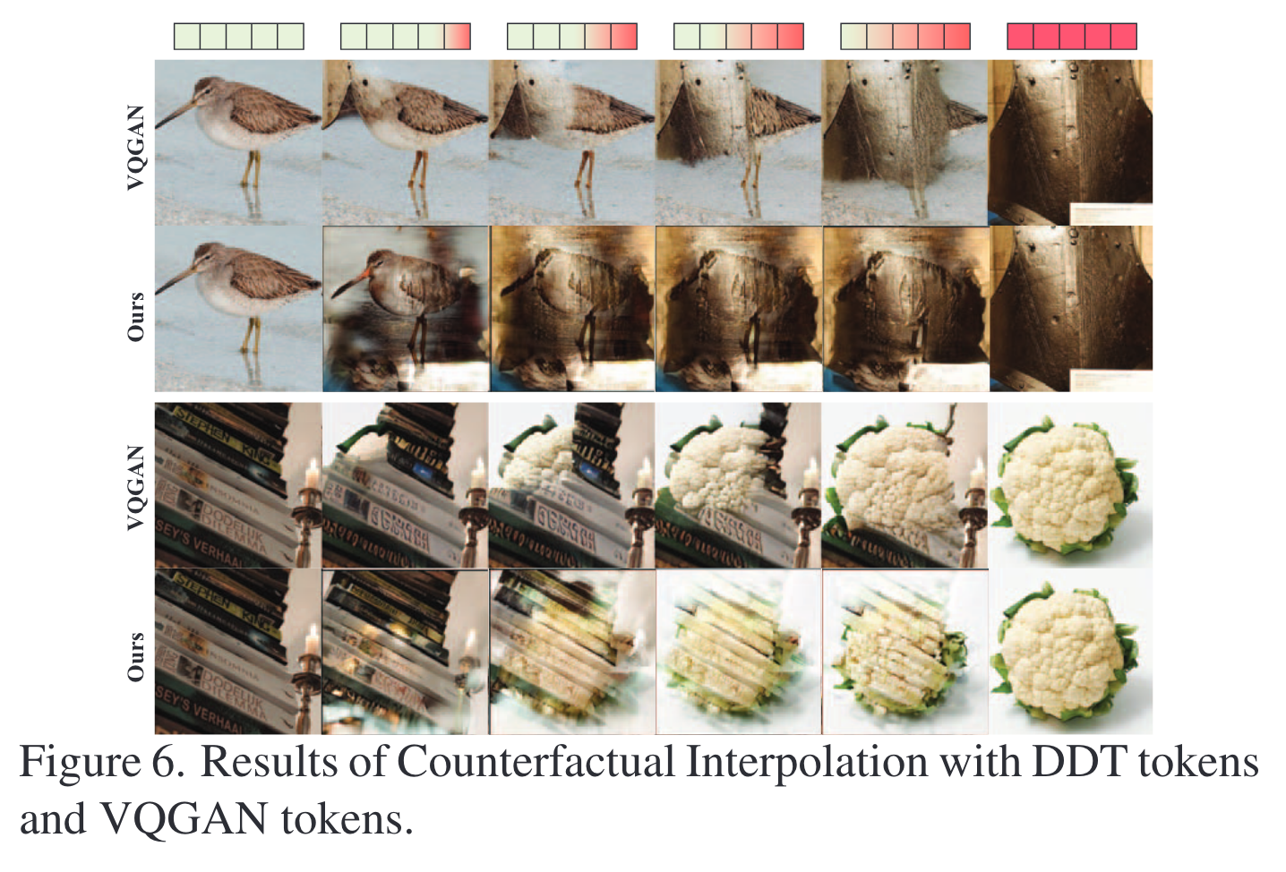
DDT Tokens are Recursive
Counterfactual interpolation
Replace a subset of tokens with those from another image
DDT tokens ensure that only the attributes captured by the substituted tokens change in the generated counterfactuals
Allow seamless semantic blending
Notes:
VQGAN performs CutMix

Slide 23
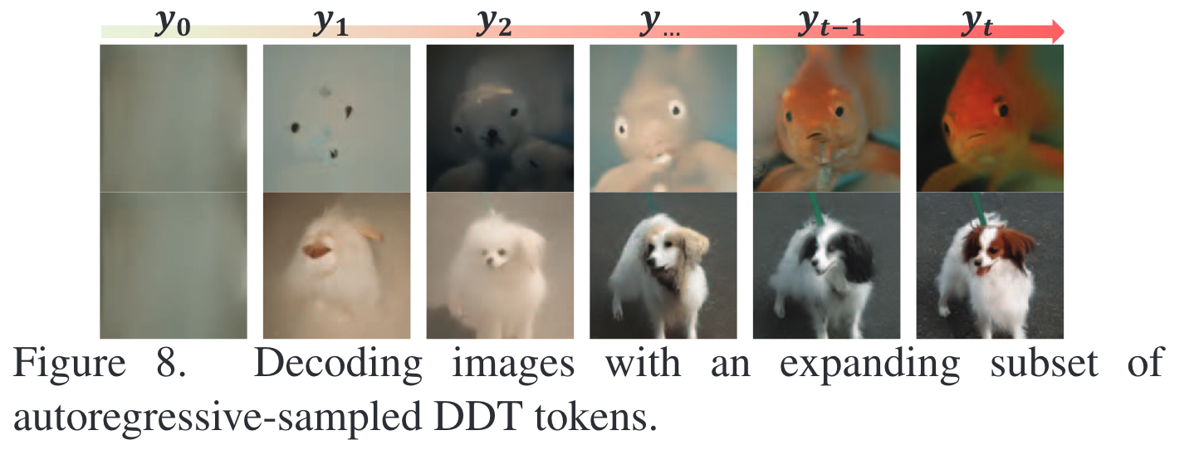
DDT Tokens are Recursive
Input a subset of the first t timestep tokens that are autoregressively sampled by DDT-LLaMA, into the decoder for image synthesis
Image’s attributes are progressively recovered when increasing the number of tokens

Slide 24
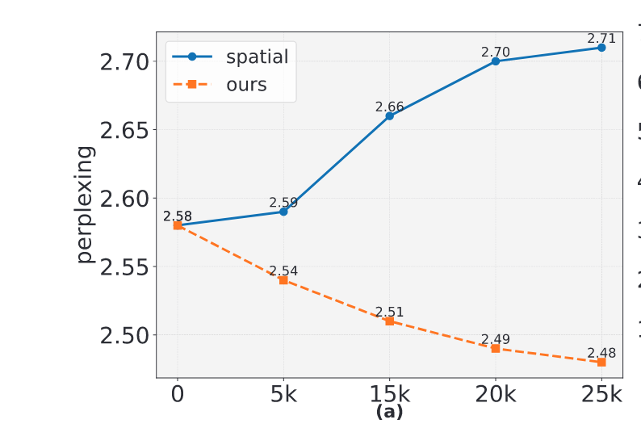
Comprehension ability
Perplexity of text generation
Lower means the model is more confident and less confused with the generated text

Slide 25
Summary
Propose DDT to learn discrete, recursive visual tokens by recovering visual attributes lost in the diffusion process
Show the outperformance and potential of the new MLLM based on DDT tokenization

Slide 26
Logic Flow
Introduction
MLLM comprehension and generalization challenges
Two directions: cascading and tokenization (figures)
Problem: spatial tokens are impossible language for LLM to master (figure)
Proposed method and contribution
Method
overview
encoder architecture (figure from previous paper)
quantizer (how to update the dictionary)
MLLM training

